Slide 1


<Yangle Ma>
<2024-07-31>

Slide 2

Outline
Executive Summary
Introduction
Methodology
Results
Conclusion
Appendix

Slide 3
Executive Summary
Summary of methodologies
Data Collection and Wrangling：
EDA and Visual analytics
EDA and SQL
interactive map with Folium
Plotly Dash dashboard
required predictive analysis
Summary of all results
Both achive the requirements and peform well

Slide 4
Introduction
Project background and context
SpaceX advertises Falcon 9 rocket launches on its website with a cost of 62 million dollars; other providers cost upward of 165 million dollars each, much of the savings is because SpaceX can reuse the first stage.
Problems you want to find answers
I would like to figure out whats the differences between the success situations and failure situation and apply changes to improve the launch success rate.

Slide 5

Section 1

Slide 6
Methodology
Executive Summary
Data collection methodology:
By importing request and relevant libraries, i collected the requied data by Web scrapling and using the requests function with url successfully.
Perform data wrangling
Clean the missing value by using the mean values to fill. Define the ‘class’ feature to identify whether succeed or not of the launch
Perform exploratory data analysis (EDA) using visualization and SQL
Perform interactive visual analytics using Folium and Plotly Dash
Perform predictive analysis using classification models
By builing mutiple models,using GridSearchCV to fit best parameters and evaulate the abilities by using score and metrix functions in test set.

Slide 7
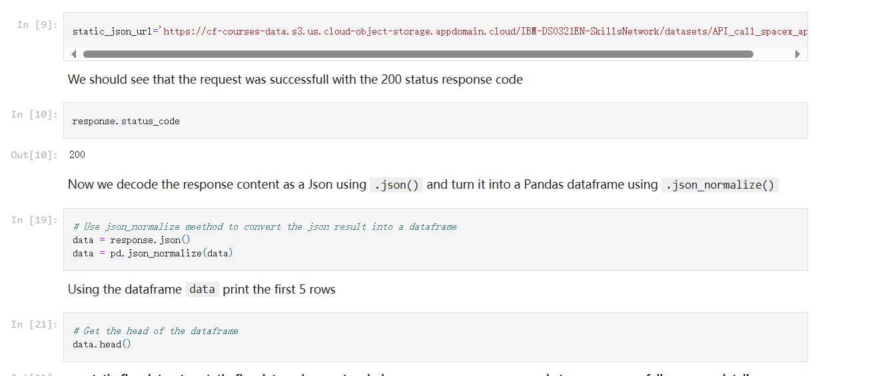
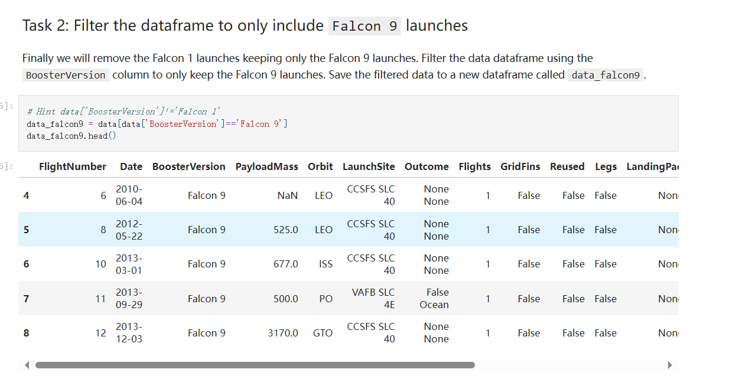
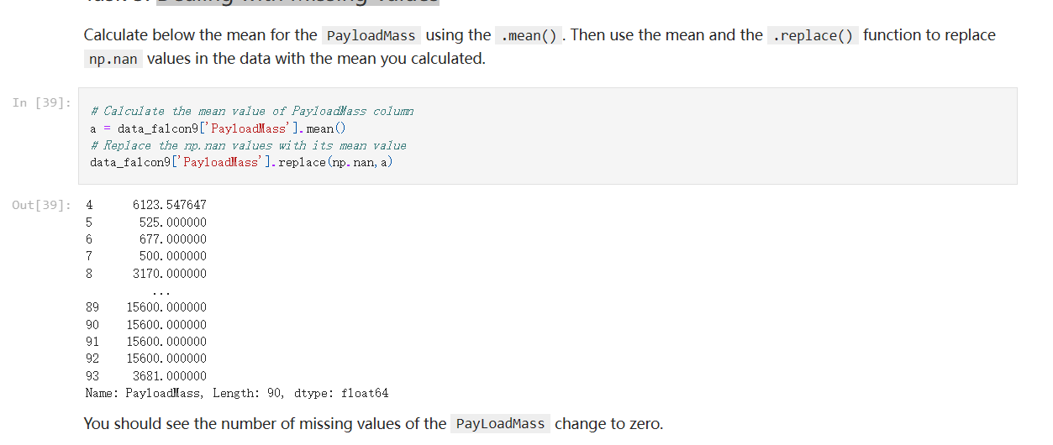
Data Collection
Describe how data sets were collected.
You need to present your data collection process use key phrases and flowcharts
2. Filter the dataframe to only include Falcon 9 launches
3. Dealing with Missing Values
1. GET request for the Space Launch Site

Slide 8
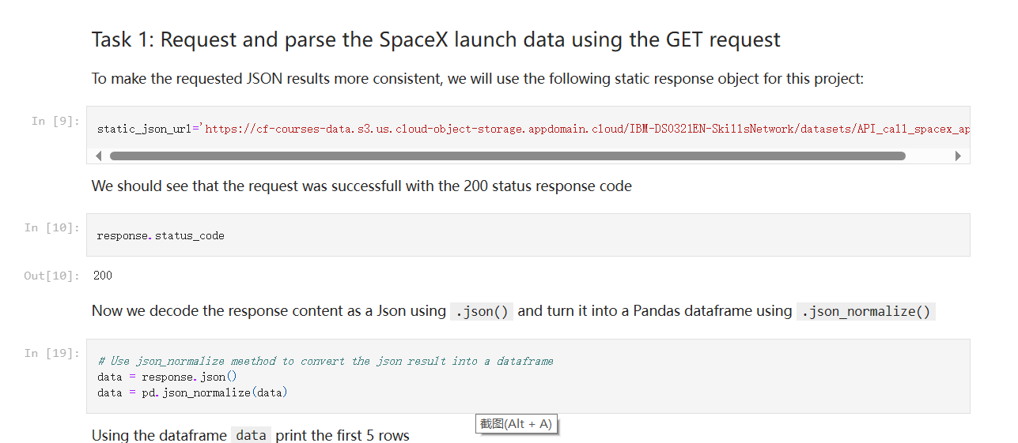
Data Collection – SpaceX API
Present your data collection with SpaceX REST calls using key phrases and flowcharts
Add the GitHub URL of the completed SpaceX API calls notebook (must include completed code cell and outcome cell), as an external reference and peer-review purpose
Place your flowchart of SpaceX API calls here
https://github.com/MaYangle/IBM-Data-Science/blob/main/Applied%20Data%20Science%20Capstone/Collecting%20the%20Data/jupyter-labs-spacex-data-collection-api.ipynb

Slide 9
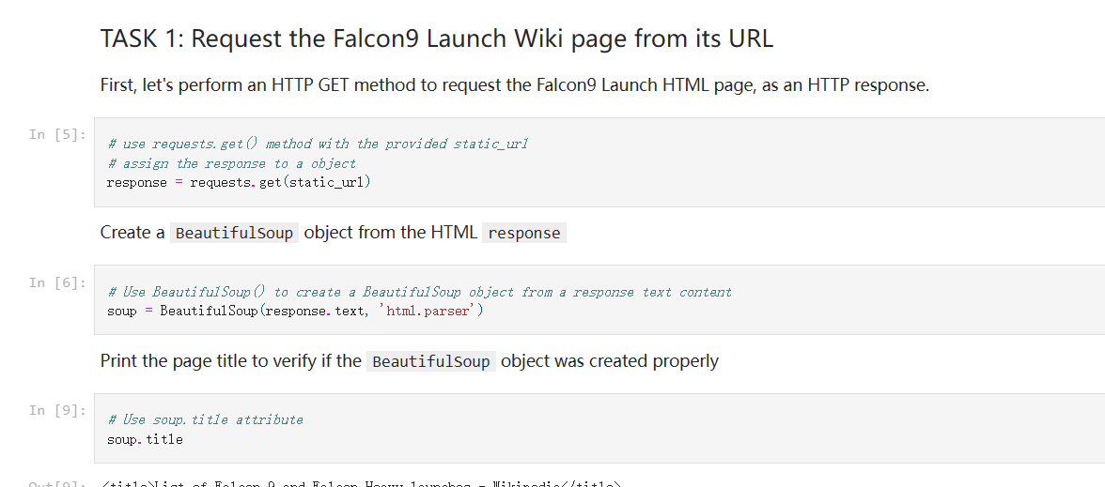
Data Collection - Scraping
Present your web scraping process using key phrases and flowcharts
Add the GitHub URL of the completed web scraping notebook, as an external reference and peer-review purpose
https://github.com/MaYangle/IBM-Data-Science/blob/main/Applied%20Data%20Science%20Capstone/Collecting%20the%20Data/jupyter-labs-webscraping.ipynb
https://github.com/MaYangle/IBM-Data-Science/blob/main/Applied%20Data%20Science%20Capstone/Collecting%20the%20Data/jupyter-labs-webscraping.ipynb

Slide 10
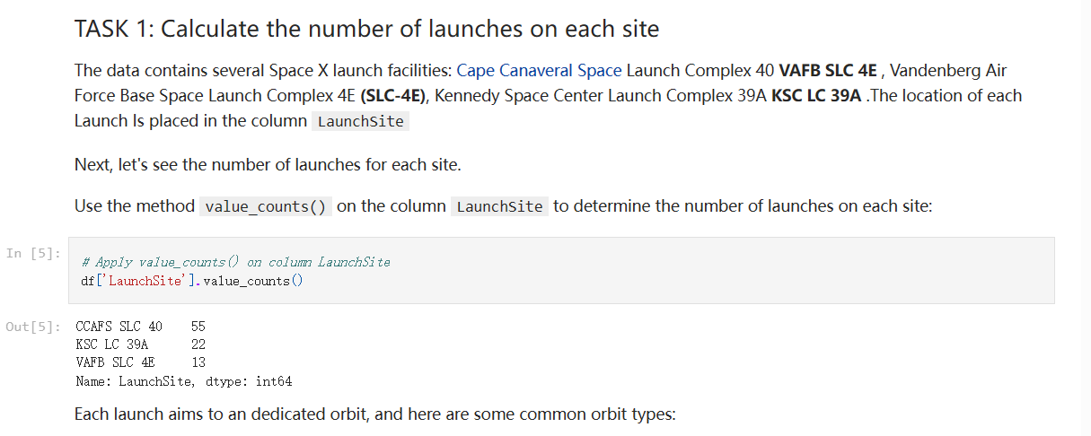
Data Wrangling
Describe how data were processed
convert those outcomes into Training Labels with 1 means the booster successfully landed 0 means it was unsuccessful.
You need to present your data wrangling process using key phrases and flowcharts
Add the GitHub URL of your completed data wrangling related notebooks, as an external reference and peer-review purpose
https://github.com/MaYangle/IBM-Data-Science/blob/main/Applied%20Data%20Science%20Capstone/Collecting%20the%20Data/labs-jupyter-spacex-Data%20wrangling.ipynb

Slide 11
EDA with Data Visualization
Summarize what charts were plotted and why you used those charts
Scatter plot charts for Flight number and Launch Site,Payload mass and Launch Site Flight number and Orbit type,Payload mass and Orbit type to see their relationships.
Bar chart for success rate and Orbit type to see their relationship.
Line chart to see the trend of success rate with years.
Add the GitHub URL of your completed EDA with data visualization notebook, as an external reference and peer-review purpose
https://github.com/MaYangle/IBM-Data-Science/blob/main/Applied%20Data%20Science%20Capstone/Exploratory%20Data%20Analysis(EDA)/edadataviz.ipynb

Slide 12
EDA with SQL
Using bullet point format, summarize the SQL queries you performed
Display the names of the unique launch sites in the space mission
Display 5 records where launch sites begin with the string 'CCA'
Display the total payload mass carried by boosters launched by NASA (CRS)
Display average payload mass carried by booster version F9 v1.1
List the date when the first succesful landing outcome in ground pad was acheived.
List the names of the boosters which have success in drone ship and have payload mass greater than 4000 but less than 6000
List the total number of successful and failure mission outcomes
List the names of the booster_versions which have carried the maximum payload mass. Use a subquery
List the records which will display the month names, failure landing_outcomes in drone ship ,booster versions, launch_site for the months in year 2015.
Rank the count of landing outcomes (such as Failure (drone ship) or Success (ground pad)) between the date 2010-06-04 and 2017-03-20, in descending order.
Add the GitHub URL of your completed EDA with SQL notebook, as an external reference and peer-review purpose
https://github.com/MaYangle/IBM-Data-Science/blob/main/Applied%20Data%20Science%20Capstone/Exploratory%20Data%20Analysis(EDA)/jupyter-labs-eda-sql-coursera_sqllite.ipynb

Slide 13
Build an Interactive Map with Folium
Summarize what map objects such as markers, circles, lines, etc. you created and added to a folium map
Create and add folium.Circle and folium.Marker for each launch site on the site map
For each launch result in spacex_df data frame, add a folium.Marker to marker_cluster
Mark down the point and add a coasting line
Explain why you added those objects
To see whether there exists the similarities in their locations.
To distinguish every launch sites
To see their distances between the local sites.
Add the GitHub URL of your completed interactive map with Folium map, as an external reference and peer-review purpose
https://github.com/MaYangle/IBM-Data-Science/blob/main/Applied%20Data%20Science%20Capstone/Interactive%20Visual%20Analytics%20and%20Dashboard/lab_jupyter_launch_site_location.ipynb

Slide 14
Build a Dashboard with Plotly Dash
Summarize what plots/graphs and interactions you have added to a dashboard
Add a dropdown list to enable Launch Site selectio
Add a pie chart to show the total successful launches count for all sites
Add a slider to select payload range
Add a scatter chart to show the correlation between payload and launch success
Explain why you added those plots and interactions
In this way, the audience can easily figure out the success rate for different launch sites and also easy to see the correlation between payload and success. It can be concluded how to improve or decrease the success rate.
Add the GitHub URL of your completed Plotly Dash lab, as an external reference and peer-review purpose
https://github.com/MaYangle/IBM-Data-Science/blob/main/Applied%20Data%20Science%20Capstone/Interactive%20Visual%20Analytics%20and%20Dashboard/spacex_dash_app.py

Slide 15
Predictive Analysis (Classification)
Summarize how you built, evaluated, improved, and found the best performing classification model
Use the models, evaluated by the score functions,improve by the GridSearchCV function to find the best parameters and see the final scores of each models to select the best one.
You need present your model development process using key phrases and flowchart
Add the GitHub URL of your completed predictive analysis lab, as an external reference and peer-review purpose
https://github.com/MaYangle/IBM-Data-Science/blob/main/Applied%20Data%20Science%20Capstone/Predictive%20Analysis%EF%BC%88Classification%EF%BC%89/SpaceX_Machine%20Learning%20Prediction_Part_5.ipynb

Slide 16
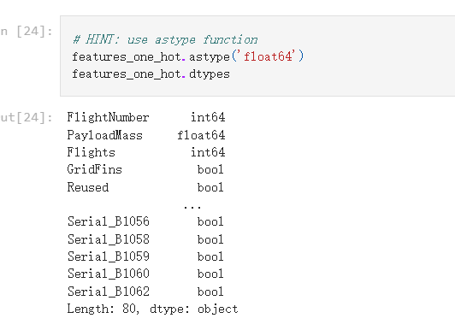
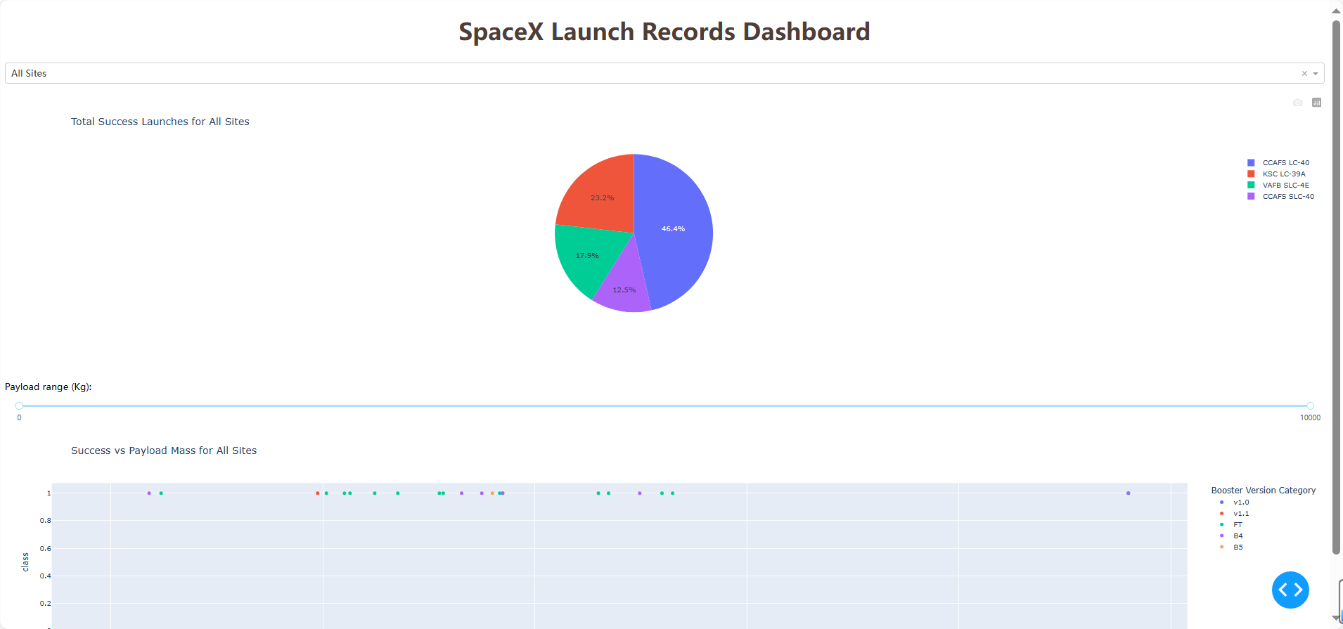
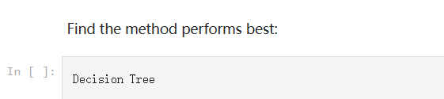
Results
Exploratory data analysis results
Interactive analytics demo in screenshots
Predictive analysis results

Slide 17

Section 2

Slide 18
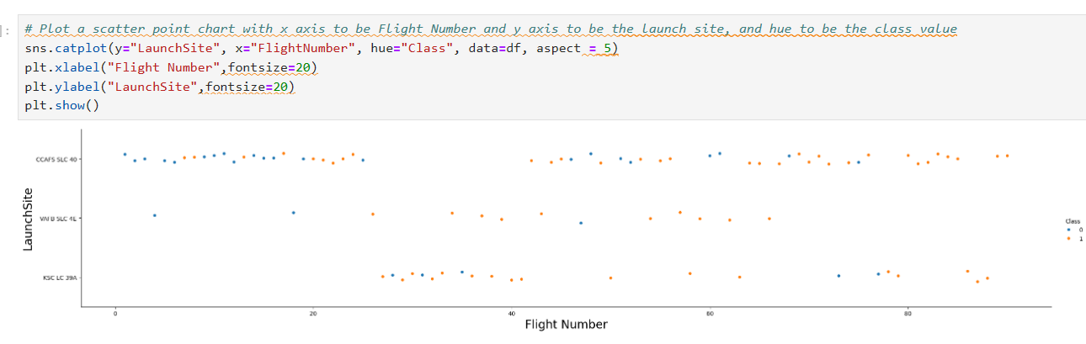
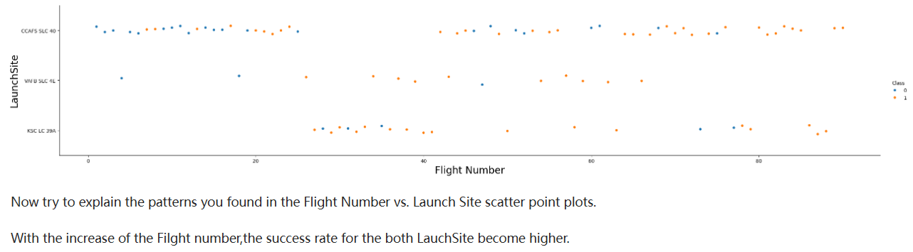
Flight Number vs. Launch Site
Show a scatter plot of Flight Number vs. Launch Site
Show the screenshot of the scatter plot with explanations

Slide 19
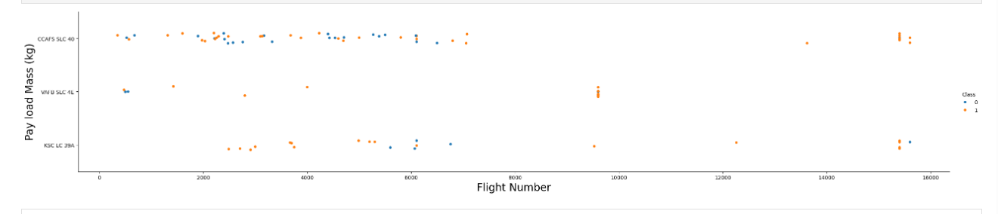
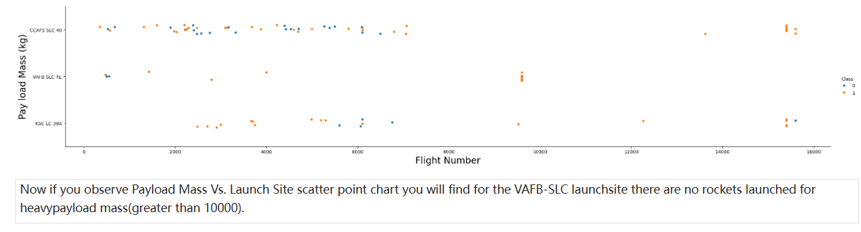
Payload vs. Launch Site
Show a scatter plot of Payload vs. Launch Site
Show the screenshot of the scatter plot with explanations

Slide 20
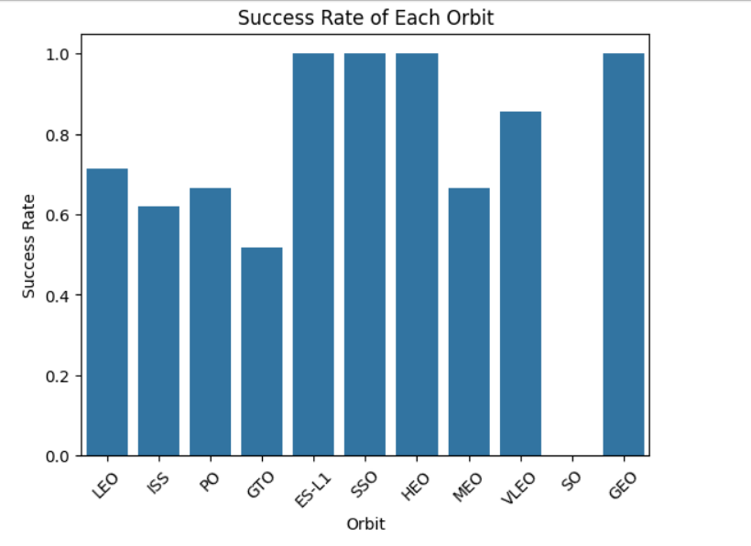
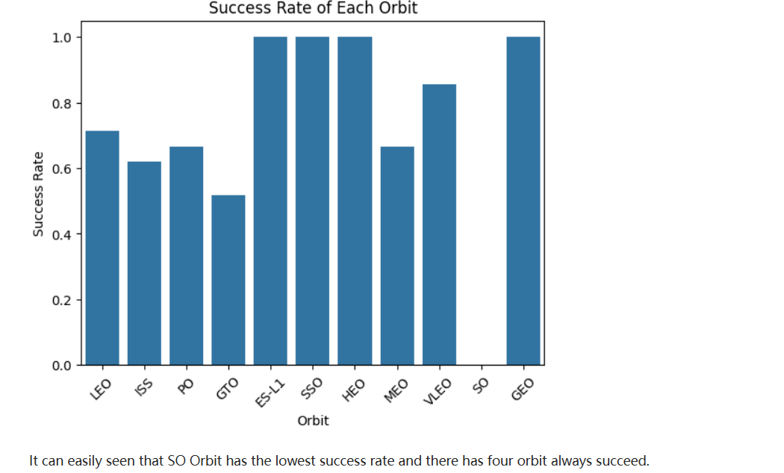
Success Rate vs. Orbit Type
Show a bar chart for the success rate of each orbit type
Show the screenshot of the scatter plot with explanations

Slide 21
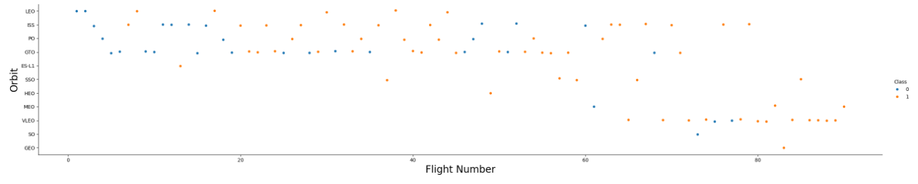
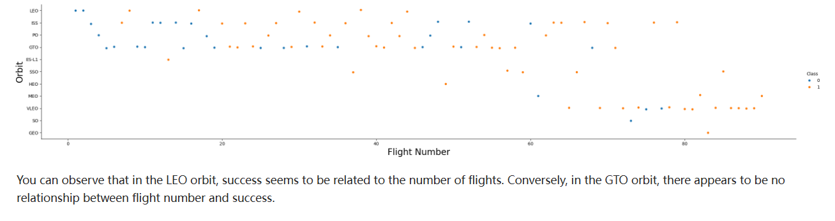
Flight Number vs. Orbit Type
Show a scatter point of Flight number vs. Orbit type
Show the screenshot of the scatter plot with explanations

Slide 22
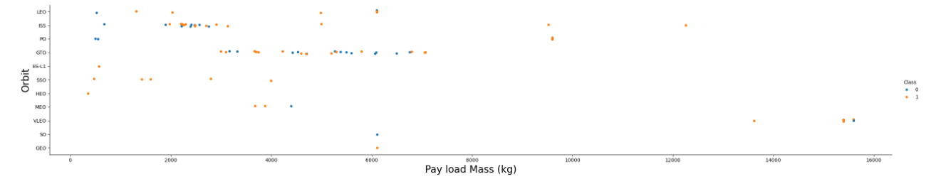
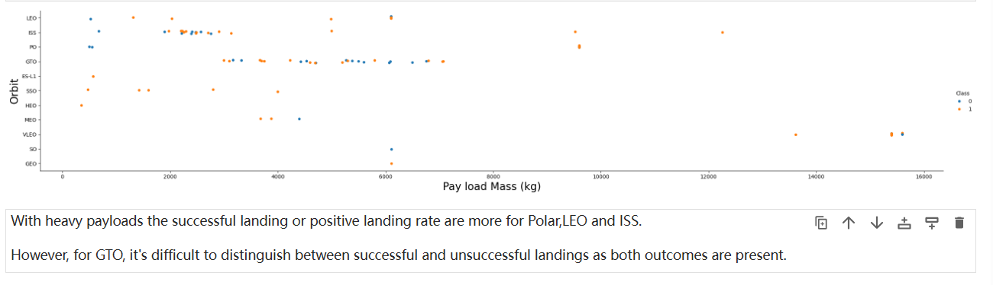
Payload vs. Orbit Type
Show a scatter point of payload vs. orbit type
Show the screenshot of the scatter plot with explanations

Slide 23
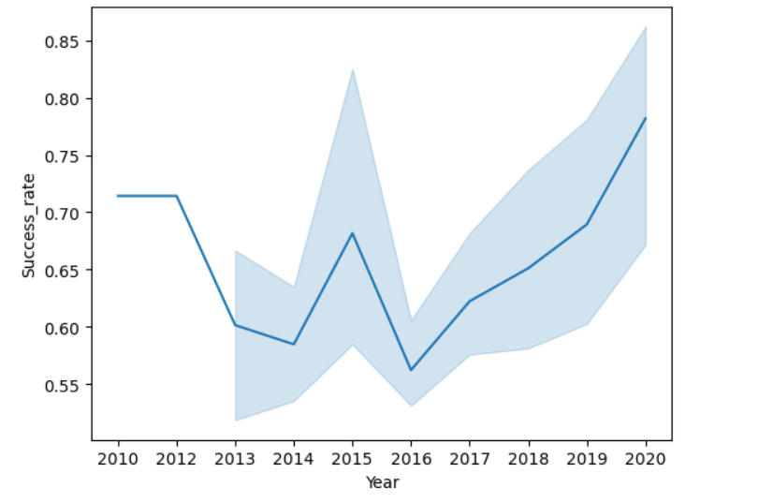
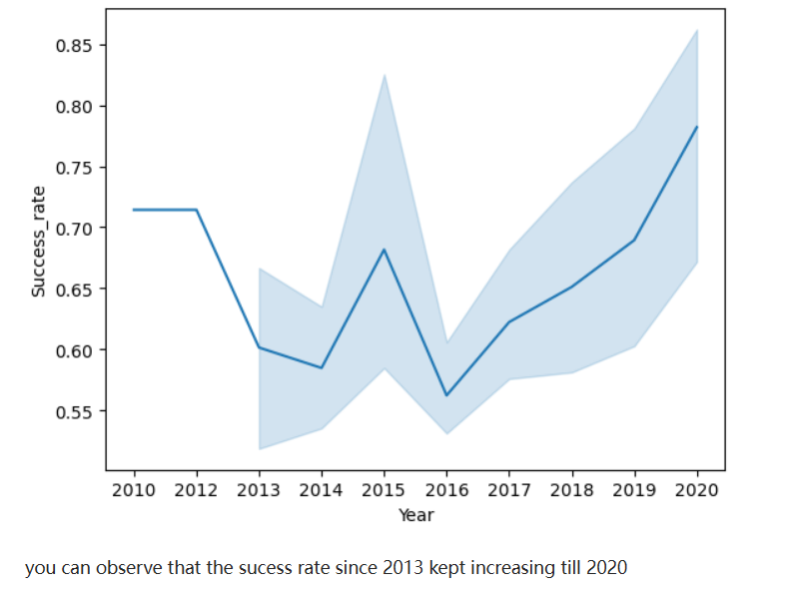
Launch Success Yearly Trend
Show a line chart of yearly average success rate
Show the screenshot of the scatter plot with explanations

Slide 24
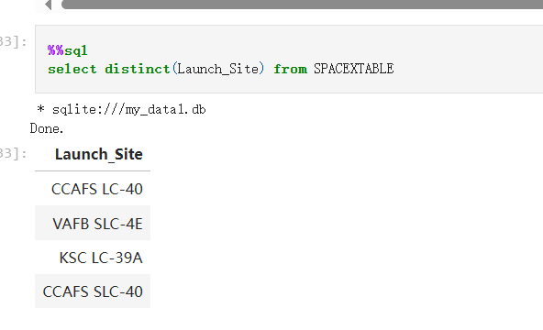
All Launch Site Names
Find the names of the unique launch sites
Present your query result with a short explanation here

Slide 25
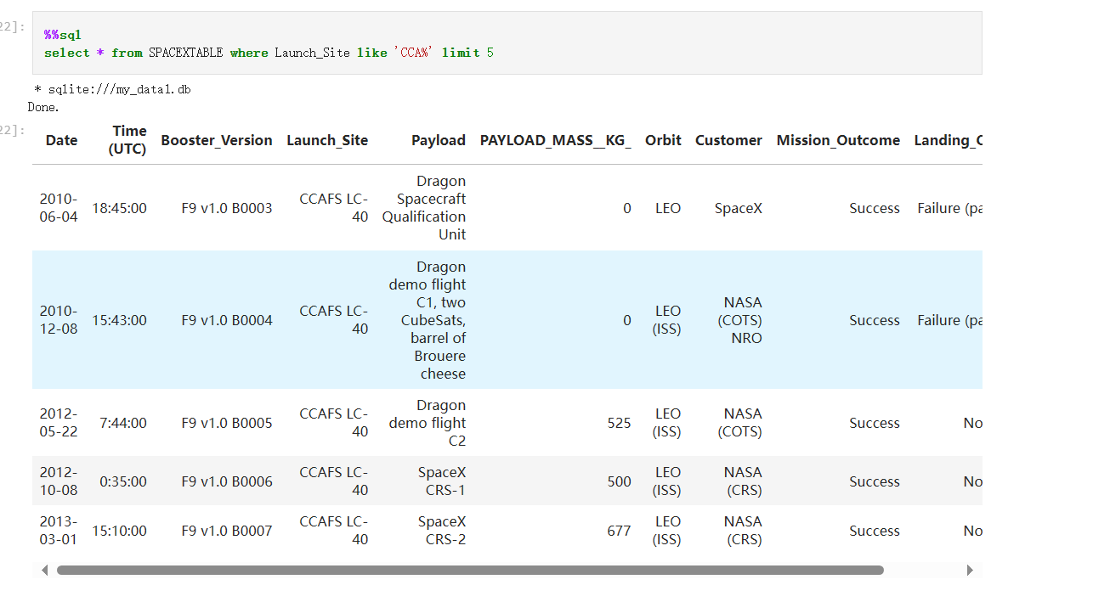
Launch Site Names Begin with 'CCA'
Find 5 records where launch sites begin with `CCA`
Present your query result with a short explanation here

Slide 26
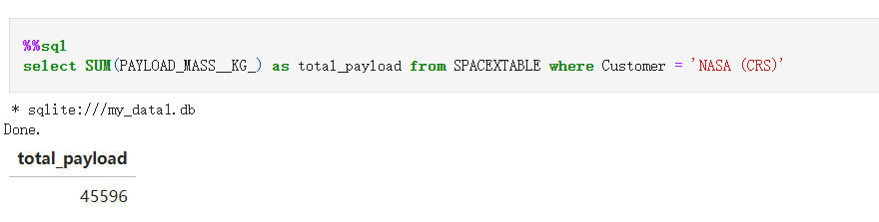
Total Payload Mass
Calculate the total payload carried by boosters from NASA
Present your query result with a short explanation here

Slide 27
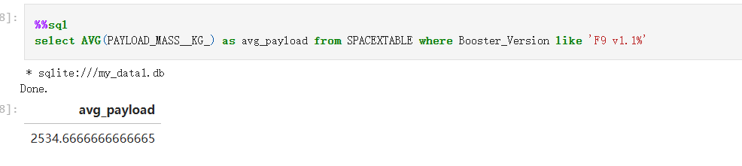
Average Payload Mass by F9 v1.1
Calculate the average payload mass carried by booster version F9 v1.1
Present your query result with a short explanation here

Slide 28
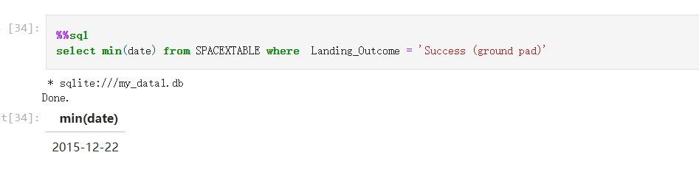
First Successful Ground Landing Date
Find the dates of the first successful landing outcome on ground pad
Present your query result with a short explanation here

Slide 29
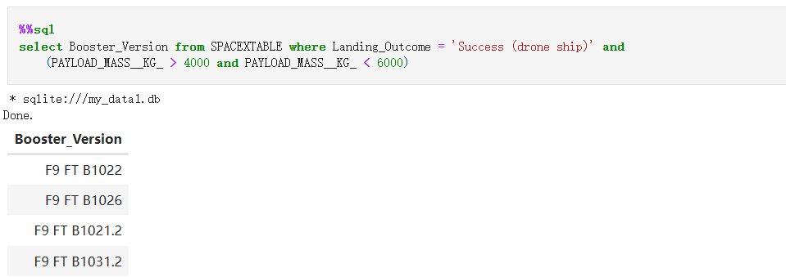
Successful Drone Ship Landing with Payload between 4000 and 6000
List the names of boosters which have successfully landed on drone ship and had payload mass greater than 4000 but less than 6000
Present your query result with a short explanation here

Slide 30
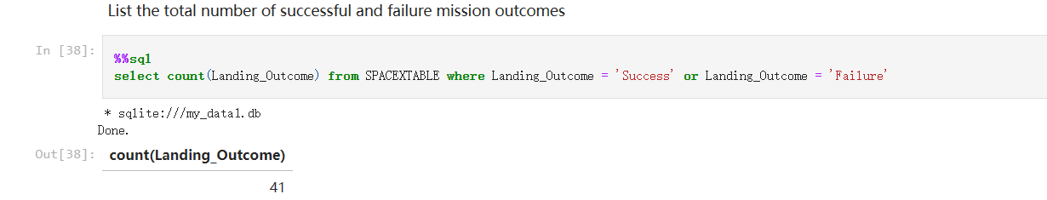
Total Number of Successful and Failure Mission Outcomes
Calculate the total number of successful and failure mission outcomes
Present your query result with a short explanation here

Slide 31
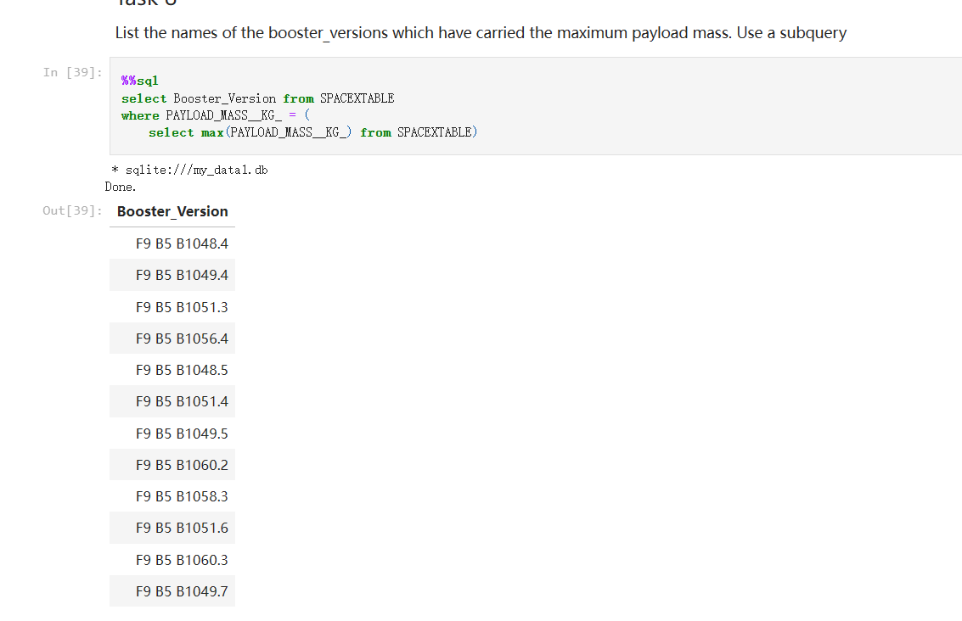
Boosters Carried Maximum Payload
List the names of the booster which have carried the maximum payload mass
Present your query result with a short explanation here

Slide 32
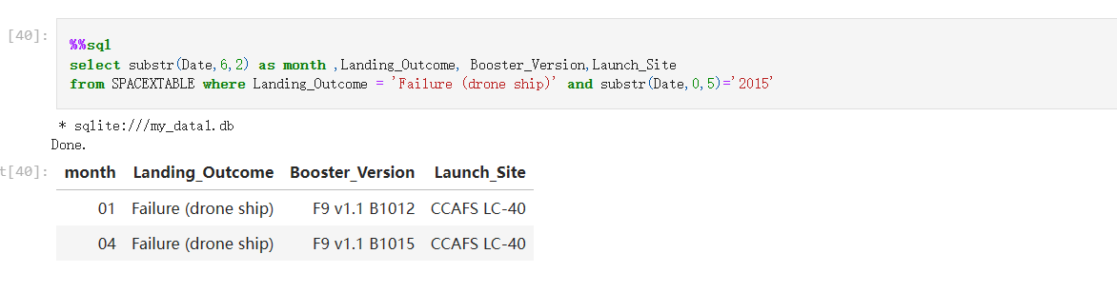
2015 Launch Records
List the failed landing_outcomes in drone ship, their booster versions, and launch site names for in year 2015
Present your query result with a short explanation here

Slide 33
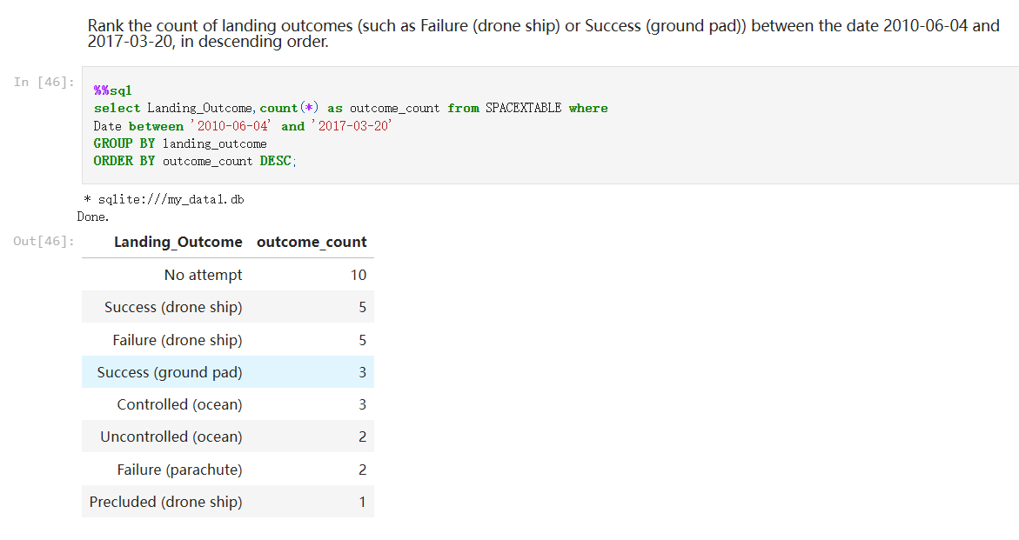
Rank Landing Outcomes Between 2010-06-04 and 2017-03-20
Rank the count of landing outcomes (such as Failure (drone ship) or Success (ground pad)) between the date 2010-06-04 and 2017-03-20, in descending order
Present your query result with a short explanation here

Slide 34

Section 3

Slide 35
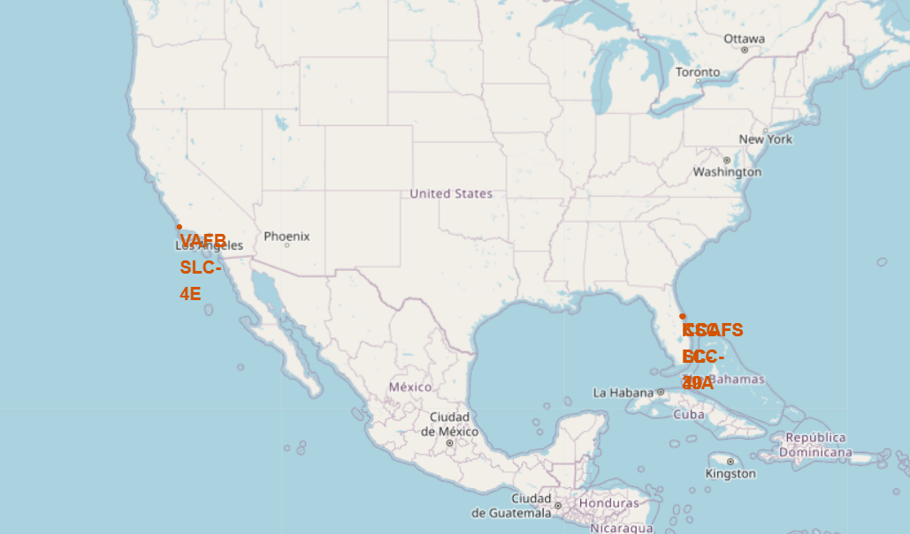
<Each launch site on the site map>
Replace <Folium map screenshot 1> title with an appropriate title
Explore the generated folium map and make a proper screenshot to include all launch sites’ location markers on a global map
Explain the important elements and findings on the screenshot
I found that the launch sites are both near the coast lines.

Slide 36
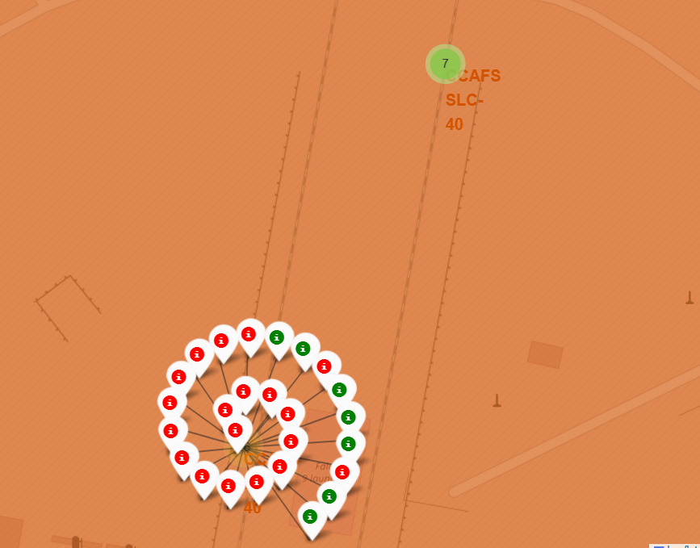
<Color for every Launch Sites>
Replace <Folium map screenshot 2> title with an appropriate title
Explore the folium map and make a proper screenshot to show the color-labeled launch outcomes on the map
Explain the important elements and findings on the screenshot
KsC LC-39A sites has higher success rate than others

Slide 37
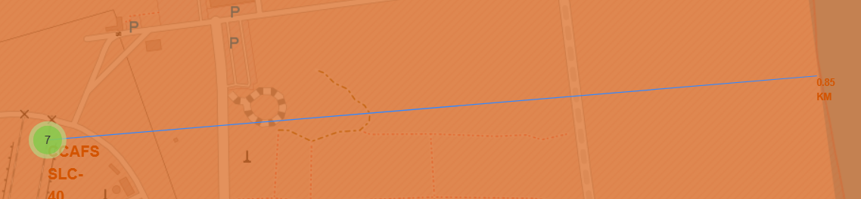
< Distances between a launch site to its proximities>
Replace <Folium map screenshot 3> title with an appropriate title
Explore the generated folium map and show the screenshot of a selected launch site to its proximities such as railway, highway, coastline, with distance calculated and displayed
Explain the important elements and findings on the screenshot
Using this Display function, it can easily decide the comprehensive situations for a launch site.

Slide 38

Section 4

Slide 39
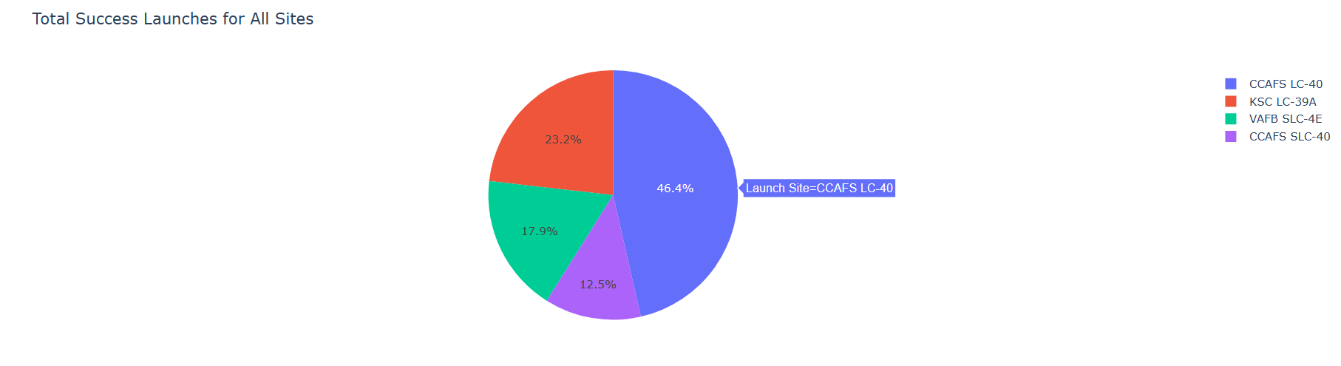
<Pie chart of launch success count for all sites>
Replace <Dashboard screenshot 1> title with an appropriate title
Show the screenshot of launch success count for all sites, in a piechart
Explain the important elements and findings on the screenshot
CCAFS LC-40 has the highest success rate, and CCAFS SLC-40 has the lowest success rate

Slide 40
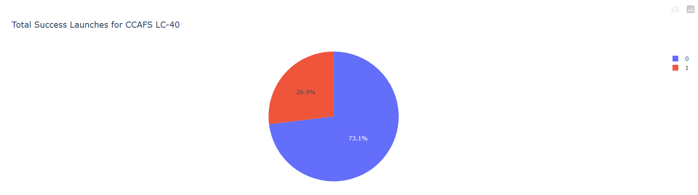
< Launch site with highest launch success rate>
Replace <Dashboard screenshot 2> title with an appropriate title
Show the screenshot of the piechart for the launch site with highest launch success ratio
Explain the important elements and findings on the screenshot
Almost three quarters of the Launches for CCAFS LC-40 was successful.

Slide 41
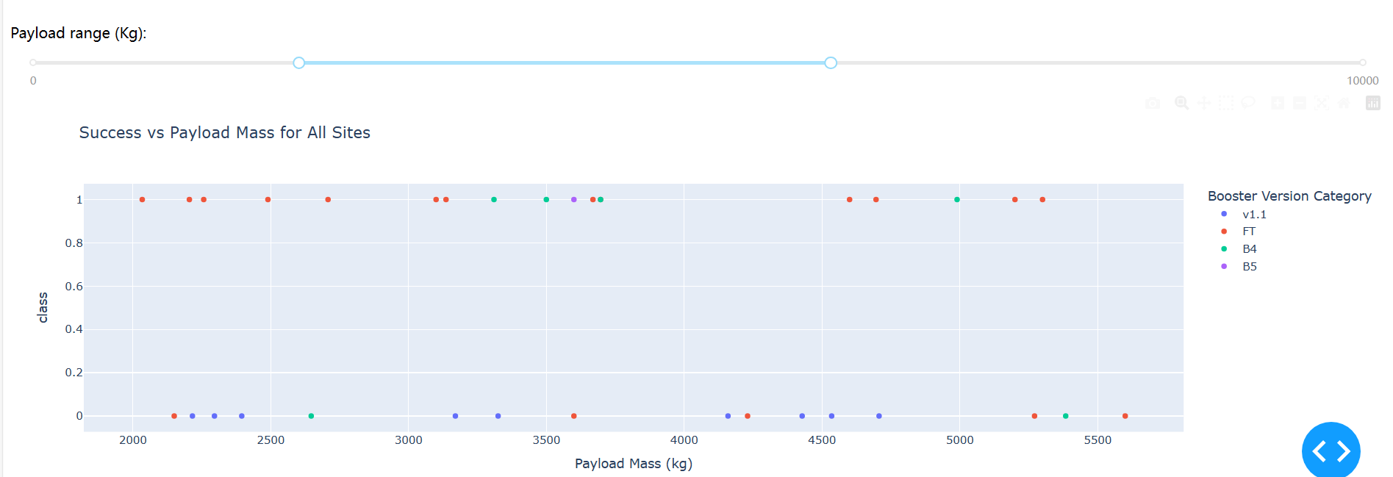
<Scatter plot for all sites>
Replace <Dashboard screenshot 3> title with an appropriate title
Show screenshots of Payload vs. Launch Outcome scatter plot for all sites, with different payload selected in the range slider
Explain the important elements and findings on the screenshot, such as which payload range or booster version have the largest success rate, etc.
FT performs good between 2k-4k,B4 seems no exact changes during different payloads.

Slide 42

Section 5

Slide 43
Classification Accuracy
Visualize the built model accuracy for all built classification models, in a bar chart
Find which model has the highest classification accuracy
Decision Tree
Too tire to get a bar chart, just forgive me for this little shortcoming.

Slide 44
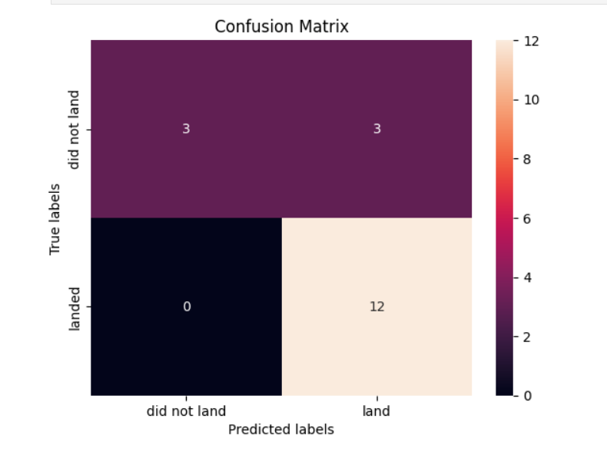
Confusion Matrix
Show the confusion matrix of the best performing model with an explanation
It perform best in train set and all models perform the same on test sets.
we dont have enough test data i guess.

Slide 45
Conclusions
Point 1 This projects inclueded all the basic skills for a Data scientist
Point 2 Using webscraping and requets function, we get the initial data and wash the format for the further processing.
Point 3 Using the different charts and Dashboards, making the results clear, we can easily see the significants of different features.
Point 4 By acheving different methods and using GridSearchCV to find the best parameters, we get the best model for the final results.

Slide 46
Appendix
Include any relevant assets like Python code snippets, SQL queries, charts, Notebook outputs, or data sets that you may have created during this project

Slide 47


